Slide 1
Music Generation with Generative Adversarial Networks
Aowei Zhao, Shuyuan Dong
CS/ECE 523 Deep Learning Project
Boston University

Slide 2
Task
Music generator: given one style and some instruments, generate a piece of music
Input:
Style(choose one): random, jazz, classical, pop, …
Instruments(Y/N): piano, drum, guitar, bass, …
Output:
Audio

Slide 3
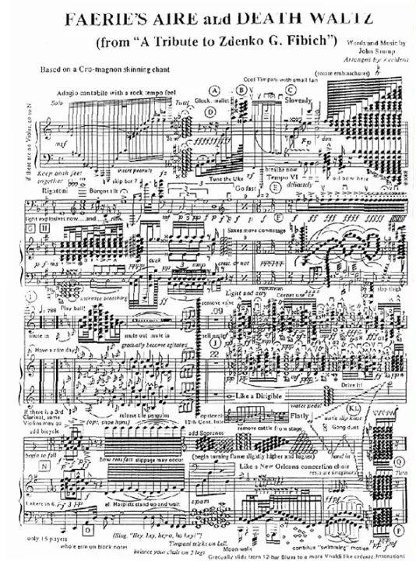
Challenge
Musical Structure is Complex
Evaluation is Subjective
Music is Diverse
…

Slide 4
Related work
OpenAI MuseNet
Transformer and attention layers
Magenta Piano Genie
CNN, encoder and decoder
MuseGAN
GAN

Slide 5
Approach
RNN+GAN
To capture past and future context
FCs
FCs
FCs
discriminator
Bidirectional
LSTM
Bidirectional LSTM
Bidirectional LSTM
FCs
FCs
FCs
generator
LSTM
LSTM
LSTM
Random noise (fake data)

Slide 6
Workpipe
Class MIDI
Parsing (.parser)
Sequence Preparation (.prepare)
MIDI File Generation (.create)
Class MODEL
Generator (.build_generator)
Discriminator (.build_discriminator)
Model Training (.train)
Loss Plotting (.plot_loss)
Model Saving (.save)
Music Generation (.generate)

Slide 7
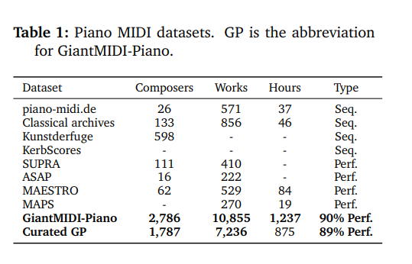
Dataset (s)
GiantMIDI-Piano
https://github.com/bytedance/GiantMIDI-Piano

Slide 8
Evaluation metric(s)
Hard to define good/bad
Country vs. Metal
 | Simple RNN | RNN+GAN
Rhythmic Complexity | 202 | 92
Pitch Rhythm Stability | 18 | 27
Music Theory Consistency | 0.3086956521 | 0.4078431372
Diversity Evaluation | 61 | 29

Slide 9
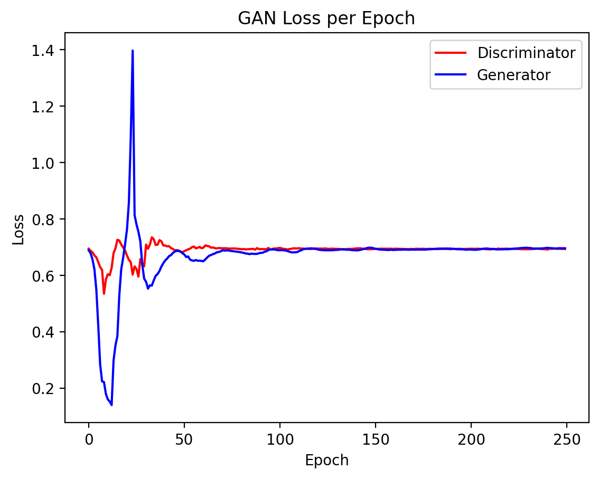
Results

Slide 10
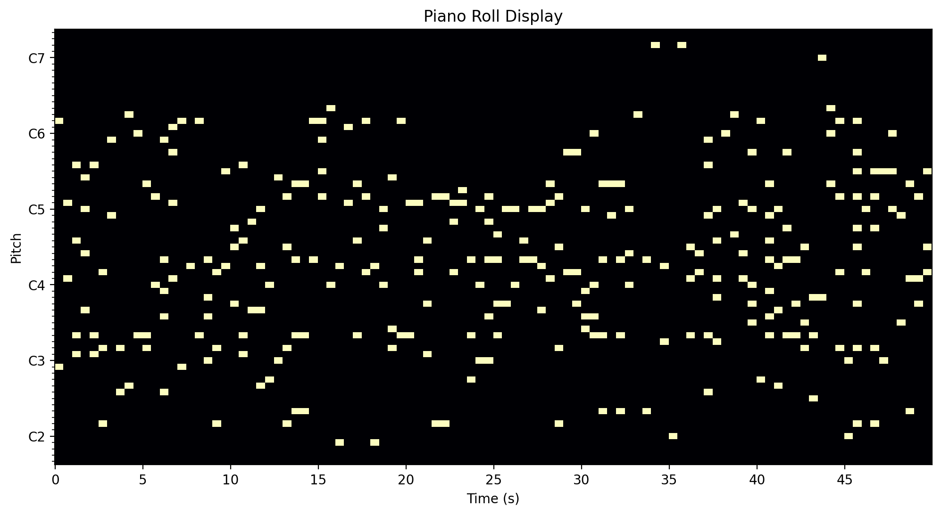

Results
Piano
Mixed

Slide 11
Conclusion
Have done:
Model realization
Basic evaluation
Will do:
Add layers
Train one style

Slide 12
Reference
[1] Qiuqiang Kong, Bochen Li, Jitong Chen, and Yuxuan Wang. "GiantMIDI-Piano: A large-scale MIDI dataset for classical piano music." arXiv preprint arXiv:2010.07061 (2020). https://arxiv.org/pdf/2010.07061
[2] https://github.com/magenta/magenta
[3] https://openai.com/research/musenet
[4] MuseGAN : Multi track sequential GANs for symbolic music generation and accompaniment,” AAAI 2018
[5] C-RNN-GAN: Continuous recurrent neural networks with adversarial training. http://mogren.one/publications/2016/c-rnn-gan/

Slide 13
THANK YOU!
&
QUESTIONS?

Slide 14
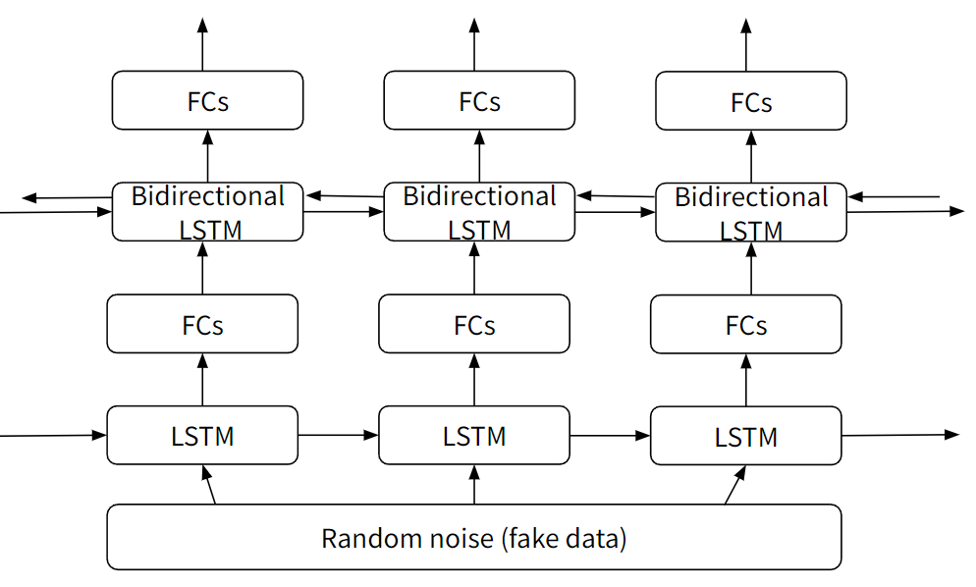
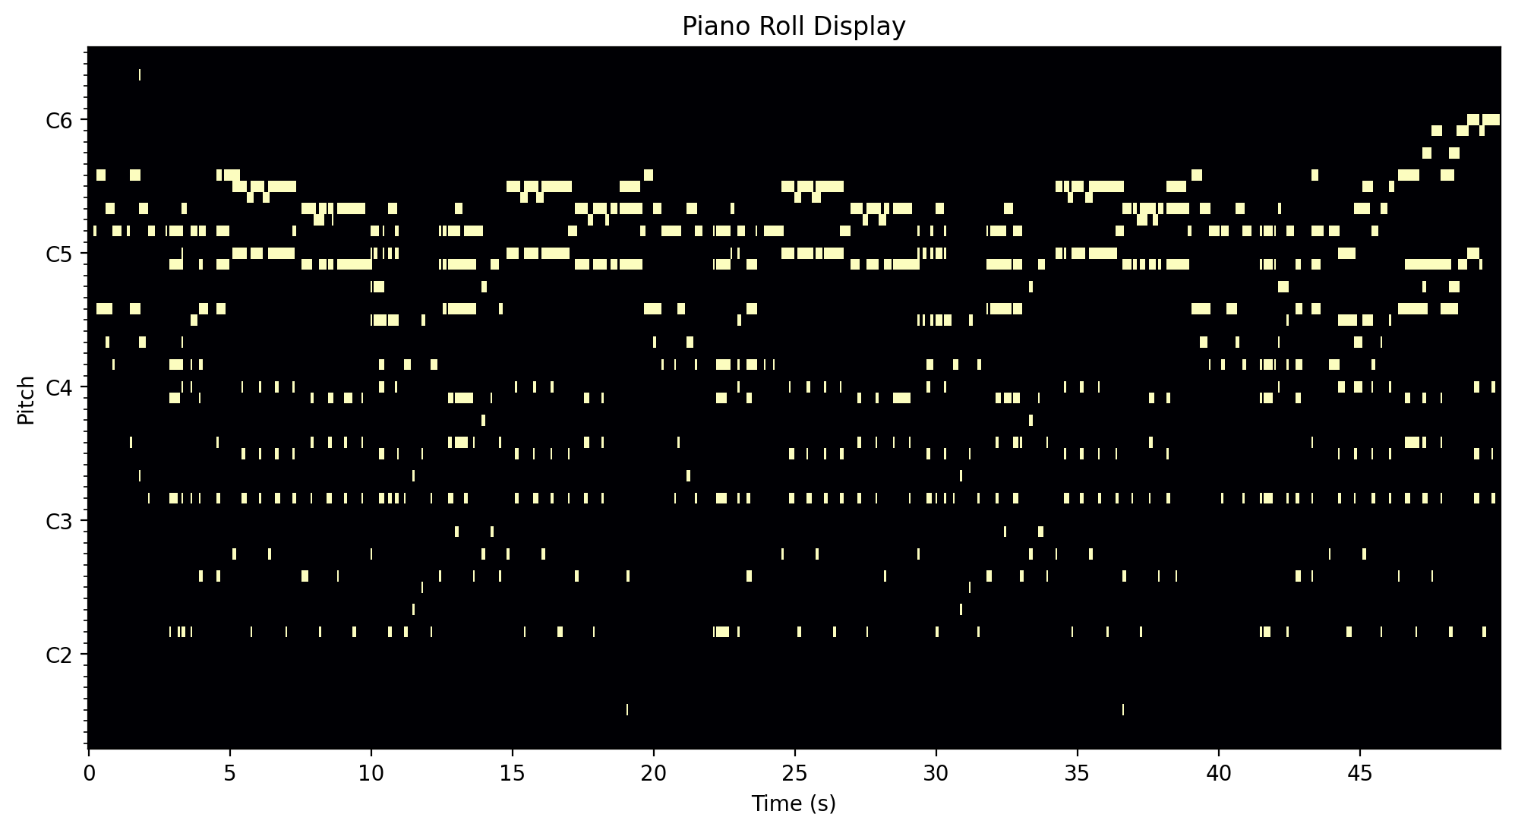
Input training midis
Generating new midi

